Slide 1



C# Advanced Topics
Methods, Arrays, Lists, Dictionaries, Strings, Classes and Objects
SoftUni Team
Technical Trainers
Software University
http://softuni.bg

Slide 2

Table of Contents
A very brief introduction to:
Arrays
Lists
Sets
Dictionaries
Strings

Slide 3
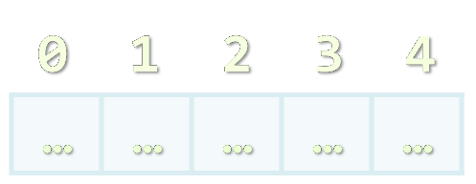
Arrays
Working with Arrays of Elements

Slide 4
What are Arrays?
In programming array is a sequence of elements
All elements are of the same type
The order of the elements is fixed
Has fixed size (Array.Length)
0 1 2 3 4
Element index
Array of 5 elements
… | … | … | … | …
Element of an array

Slide 5
Working with Arrays
Allocating an array of 10 integers:
Assigning values to the array elements:
Accessing array elements by index:
int[] numbers = new int[10];
for (int i=0; i<numbers.Length; i++)
numbers[i] = i+1;
numbers[3] = 20;
numbers[5] = numbers[2] + numbers[7];

Slide 6
Working with Arrays (2)
Printing an array:
Finding sum, minimum, maximum, first, last element:
for (int i = 0; i < numbers.Length; i++)
Console.WriteLine("numbers[{0}] = {1}", i, numbers[i]);
Ensure you have
using System.Linq;
to use aggregate functions
Console.WriteLine("Sum = " + numbers.Sum());
Console.WriteLine("Min = " + numbers.Min());
Console.WriteLine("Max = " + numbers.Max());
Console.WriteLine("First = " + numbers.First());
Console.WriteLine("Last = " + numbers.Last());

Slide 7
Arrays of Strings
You may define an array of any type, e.g. string:
string[] names = { "Peter", "Maria", "Katya", "Todor" };
names.Reverse();
names[0] = names[0] + " (junior)";
foreach (var name in names)
{
Console.WriteLine(name);
}
names[4] = "Nakov"; // This will cause an exception!

Slide 8
Two-dimensional Arrays (Matrices)
We want to build the matrix on the right
int width = 4, height = 6;
string[,] matrix =
new string[height, width];
for (int row = 0; row < height; row++)
{
for (int col = 0; col < width; col++)
{
matrix[row, col] = "" +
(char)('a' + row) +
(char)('a' + col);
}
}
0 1 2 3
0
1
2
3
4
5
aa | ab | ac | ad
ba | bb | bc | bd
ca | cb | cc | cd
da | db | dc | dd
ea | eb | ec | ed
fa | fb | fc | fd

Slide 9
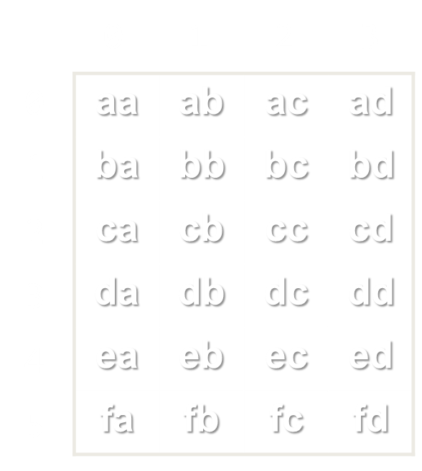
Arrays and Matrices
Live Demo

Slide 10
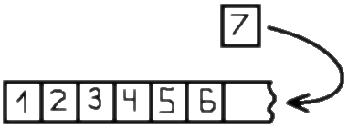
Lists of Elements
Working with List<T>

Slide 11
Lists
In C# arrays have fixed length
Cannot add / remove / insert elements
Lists are like resizable arrays
Allow add / remove / insert of elements
Lists in C# are defined through the List<T> class
Where T is the type of the list, e.g. string or int
List<int> numbers = new List<int>();
numbers.Add(5);
Console.WriteLine(numbers[0]); // 5

Slide 12
List<T> – Example
List<string> names =
new List<string>() { "Peter", "Maria", "Katya", "Todor" };
names.Add("Nakov"); // Peter, Maria, Katya, Todor, Nakov
names.RemoveAt(0); // Maria, Katya, Todor, Nakov
names.Insert(3, "Sylvia"); // Maria, Katya, Todor, Sylvia, Nakov
names[1] = "Michael"; // Maria, Michael, Todor, Sylvia, Nakov
foreach (var name in names)
{
Console.WriteLine(name);
}

Slide 13


List<T>
Live Demo

Slide 14

Set of Elements
HashSet<T>

Slide 15
Set
In C# lists can have multiple objects with the same value
There is no verification whether object exists
Sets are like no repetitive lists
Allow add / remove of unique elements
Sets in C# are defined through the HashSet<T> class
Where T is the type of the list, e.g. string or int
HashSet<string> uniqueNames = new HashSet<string>();
uniqueNames.Add("Pesho");
uniqueNames.Add("Pesho");
uniqueNames.ToList().ForEach(s => Console.WriteLine(s)); // "Pesho"

Slide 16
HashSet<T> – Example
HashSet<string> names =
new HashSet<string> { "Pete", "Maria", "Pete", "Pete" };
names.Add("Nakov"); // Pete, Maria, Nakov
names.Remove("Maria"); // Pete, Nakov
Console.WriteLine(names.Contains("Maria")); // False
foreach (var name in names)
{
Console.WriteLine(name);
}

Slide 17
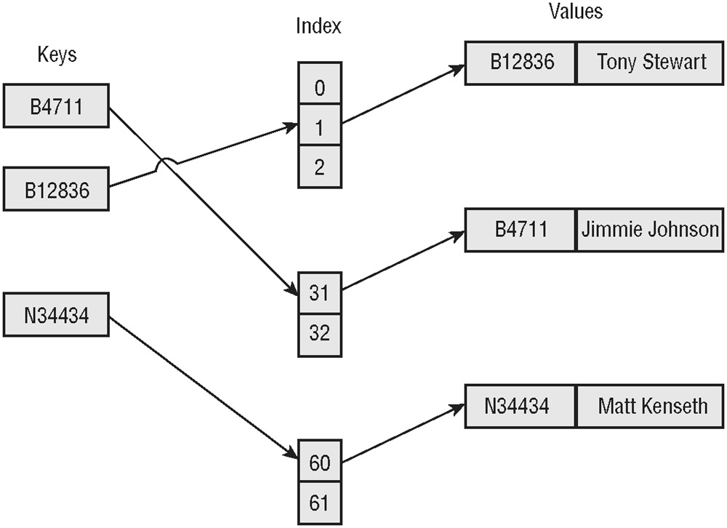
HashSet<T>
Live Demo

Slide 18
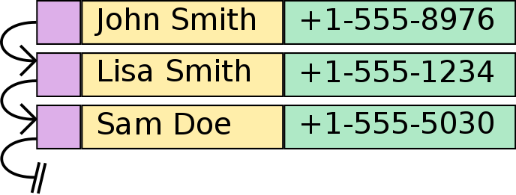
Associative Arrays
Dictionary<Key, Value>

Slide 19
Associative Arrays (Maps, Dictionaries)
Associative arrays are arrays indexed by keys
Not by the numbers 0, 1, 2, …
Hold a set of pairs <key, value>
Traditional array
Associative array
key
value
key
0 1 2 3 4
John Smith | +1-555-8976
Lisa Smith | +1-555-1234
Sam Doe | +1-555-5030
value
8 | -3 | 12 | 408 | 33

Slide 20
Phonebook – Example
Dictionary<string, string> phonebook =
new Dictionary<string, string>();
phonebook["John Smith"] = "+1-555-8976";
phonebook["Lisa Smith"] = "+1-555-1234";
phonebook["Sam Doe"] = "+1-555-5030";
phonebook["Nakov"] = "+359-899-555-592";
phonebook["Nakov"] = "+359-2-981-9819";
phonebook.Remove("John Smith");
foreach (var pair in phonebook)
{
Console.WriteLine("{0} --> {1}", entry.Key, entry.Value);
}

Slide 21
Events – Example
Dictionary<DateTime, string> events =
new Dictionary<DateTime, string>();
events[new DateTime(1998, 9, 4)] = "Google's birth date";
events[new DateTime(2013, 11, 5)] = "SoftUni's birth date";
events[new DateTime(1975, 4, 4)] = "Microsoft's birth date";
events[new DateTime(2004, 2, 4)] = "Facebook's birth date";
events[new DateTime(2013, 11, 5)] =
"Nakov left Telerik Academy to establish SoftUni";
foreach (var entry in events)
{
Console.WriteLine("{0:dd-MMM-yyyy}: {1}",
entry.Key, entry.Value);
}

Slide 22
Associative Arrays
Live Demo

Slide 23
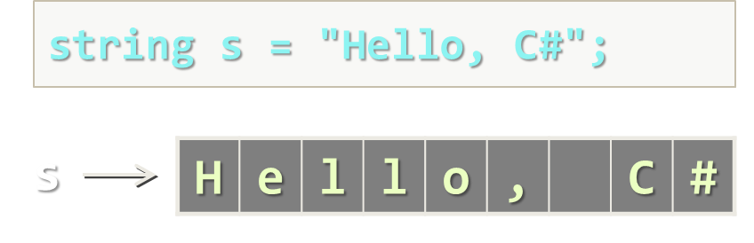
Strings
Basic String Operations

Slide 24
What Is String?
Strings are indexed sequences of Unicode characters
Represented by the string data type in C#
Also known as System.String
Example:
string s = "Hello, SoftUni!";
s
H | e | l | l | o | , |  | S | o | f | t | U | n | i | !
0 1 2 3 4 5 6 7 8 9 10 11 12 13 14

Slide 25
Working with Strings in C#
Strings in C#
Knows its number of characters – Length
Can be accessed by index (0 … Length-1)
Strings are stored in the dynamic memory (managed heap)
Can have null value (missing value)
Strings cannot be modified (immutable)
Most string operations return a new string instance
StringBuilder class is used to build stings

Slide 26
Strings – Examples
string str = "SoftUni";
Console.WriteLine(str);
for (int i = 0; i < str.Length; i++)
{
Console.WriteLine("str[{0}] = {1}", i, str[i]);
}
Console.WriteLine(str.IndexOf("Uni")); // 4
Console.WriteLine(str.IndexOf("uni")); // -1 (not found)
Console.WriteLine(str.Substring(4, 3)); // Uni
Console.WriteLine(str.Replace("Soft", "Hard")); // HardUni
Console.WriteLine(str.ToLower()); // softuni
Console.WriteLine(str.ToUpper()); // SOFTUNI

Slide 27
Strings – Examples (2)
string firstName = "Steve";
string lastName = "Jobs";
int age = 56;
Console.WriteLine(firstName + " " + lastName +
" (age: " + age + ")"); // Steve Jobs (age: 56)
string allLangs = "C#, Java; HTML, CSS; PHP, SQL";
string[] langs = allLangs.Split(new char[] {',', ';', ' '},
StringSplitOptions.RemoveEmptyEntries);
foreach (var lang in langs)
Console.WriteLine(lang);
Console.WriteLine("Langs = " + string.Join(", ", langs));
Console.WriteLine(" \n\n Software University ".Trim());

Slide 28
Strings
Live Demo

Slide 29

Summary
Arrays are indexed blocks of elements (fixed-length)
Lists are indexed sequences of elements (variable-length)
Sets are hashed sequences of unique elements
Dictionaries map keys to values and provide fast access by key
Strings are indexed sequences of characters

Slide 30







C# Advanced Topics
http://softuni.bg/courses/csharp-basics

Slide 31
License
This course (slides, examples, demos, videos, homework, etc.) is licensed under the "Creative Commons Attribution-NonCommercial-ShareAlike 4.0 International" license
Attribution: this work may contain portions from
"Fundamentals of Computer Programming with C#" book by Svetlin Nakov & Co. under CC-BY-SA license

Slide 32





Free Trainings @ Software University
Software University Foundation – softuni.org
Software University – High-Quality Education, Profession and Job for Software Developers
softuni.bg
Software University @ Facebook
facebook.com/SoftwareUniversity
Software University @ YouTube
youtube.com/SoftwareUniversity
Software University Forums – forum.softuni.bg

